Slide 1
CS-2011 — Machine Organization and Assembly Language
Professor Hugh C. Lauer CS-2011, Machine Organization and Assembly Language
(Slides include copyright materials from Computer Systems: A Programmer’s Perspective, by Bryant and O’Hallaron, and from The C Programming Language, by Kernighan and Ritchie)

Slide 2
Overview
A tantalizing problem (or two)
Course introduction and logistics
Course Survey and Photos
Datalab assignment
Course overview and theme

Slide 3
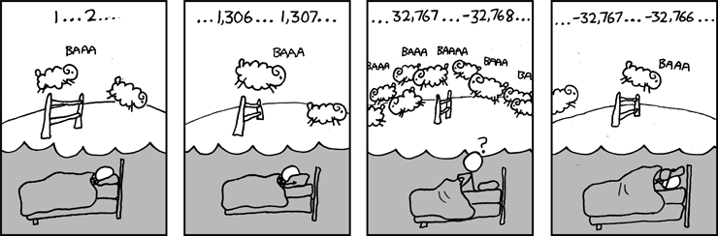
Two Tantalizing Problems
Is x² ≥ 0?
Float’s: Yes!
Int’s:
40000 * 40000 ➙ 1,600,000,000
50000 * 50000 ➙ ??
Example 2: Is (x + y) + z = x + (y + z)?
Unsigned & Signed Int’s: Yes!
Float’s:
(1e20 + -1e20) + 3.14 --> 3.14
1e20 + (-1e20 + 3.14) --> ??
-352,516,352
Source: xkcd.com/571

Slide 4
Computer Arithmetic
Does not generate random values
Arithmetic operations have important mathematical properties
Cannot assume all “usual” mathematical properties
Due to finiteness of representations
Integer operations satisfy “ring” properties
Commutativity, associativity, distributivity
Floating point operations satisfy “ordering” properties
Monotonicity, values of signs
Observation
Need to understand which abstractions apply in which contexts
Important issues for compiler writers and serious application programmers

Slide 5
This course
Understand how numbers are represented in modern computers
And the inner workings of arithmetic!
Read and work with Intel x86 and x86_64 assembly language
Understand how C compiles to machine code
Understand how modern computers work
At 2000-level course

Slide 6
Role within CS Curriculum
CS-2301 Sys Prog. for non-majors
CS-2303 System Prog. Concepts
OR
CS-2011 Machine Org & Assembly Lang.
CS-3516 Computer Networks
CS-3013 Operating Systems
CS-4516 Advanced Networks
CS-4513 Distributed Systems
CS-4515 Computer Architecture

Slide 7
Course perspective
Most Systems Courses are Builder-Centric
Computer Architecture
Design pipelined processor in Verilog
Operating Systems
Implement large portions of operating system
Compilers
Write compiler for simple language
Networking
Implement and simulate network protocols

Slide 8
Course perspective (continued)
This course is programmer-centric
Purpose is to show how by knowing more about the underlying system, one can be more effective as a programmer
Enable you to
Write programs that are more reliable and efficient
Incorporate features that require hooks into OS
E.g., concurrency, signal handlers
Not just a course for dedicated hackers
We bring out the hidden hacker in everyone
We cover material in this course that you won’t see elsewhere

Slide 9
Course components
Lectures
Higher level concepts, applied concepts, clarifications of texts, etc.
Labs (i.e., programming) projects — 4
The heart of the course
1-2 weeks each
Provide in-depth understanding of an aspect of systems
Programming and measurement
Recitation sessions
Get started on Lab projects
Work through problems and details interactively
Weekly quizzes (5 small + 1 medium)
Test your understanding of concepts & mathematical principles
Work out problems from textbook

Slide 10
Lab rationale
All projects/labs programmed in C
Each lab has a well-defined goal such as solving a puzzle or winning a contest
Doing the lab should result in new skills and concepts
We try to use competition in a fun and healthy way
Set a reasonable threshold for full credit
Post intermediate results (anonymized) on Web page for glory!

Slide 11
More About This Course
This is not a traditional course in which
We feed you a bunch of facts and methods
We assign you homework and quizzes to demonstrate that you know those facts and methods …
… and how to apply them!
Instead, we assign you problems that you don’t know how to solve
It is your responsibility to study them early, and …
… to figure out what it is that you don’t know but need to know, and …
… to ask questions

Slide 12
More About This Course (continued)
… Ask us … Ask the textbook … Ask each other
Share your knowledge
Raise questions and have discussions at the start of any class
….

Slide 13
More About This Course (continued)
According to feedback in Course Evaluations:–
This is the most difficult course that many students have encountered so far at WPI
This course requires the most work and time of any encountered so far at WPI
The course is the most fun of any course encountered so far at WPI
At the end of the course, I hope tell you that …
… you ain’t seen nothin’ yet!

Slide 14
Logistics
Lectures:–
Monday, Tuesday, Thursday, Friday, 9:00-10:00 AM
Salisbury 115
No classes during Thanksgiving break, November 22-24,
Also, no class on Tuesday, December 12 (“Reading Day” or makeup day for snowstorms)
Quizzes:– Fridays November 3 – December 15
At start of class time. Approx 20-25 minutes (except last quiz)
You may begin as soon as you arrive in classroom
Stay in seat when you are finished
No make-up quizzes!
Best four out of six
See Professor in advance if you must be away — e.g., interviews, projects, etc.
Let me know ASAP if you are sick or injured
Anyone needing to take quiz at EPC should start early, be back in class at 9:20 AM
Last quiz is mandatory in order to pass course!

Slide 15
Logistics (continued)
Recitation sections (called “labs” by Registrar)
9:00 AM, 10:00 AM (Zoo Lab)
11:00 AM, 12:00 noon (Salisbury 123)
Attendance Counts!
Must attend your own, registered session
Space not guaranteed in later sections if you oversleep!
Waitlist:–
Please bring an ADD-DROP slip ASAP!

Slide 16
Questions?

Slide 17
Textbooks
Randal E. Bryant and David R. O’Hallaron,
“Computer Systems: A Programmer’s Perspective, Third Edition” (CS:APP3e), Prentice Hall, 2016
http://csapp.cs.cmu.edu
This book really matters for the course!
How to solve labs
Practice problems typical of quiz problems
Brian Kernighan and Dennis Ritchie,
“The C Programming Language, Second Edition,” Prentice Hall, 1988
You should keep a copy of this on your desk for the rest of your (professional) life!

Slide 18

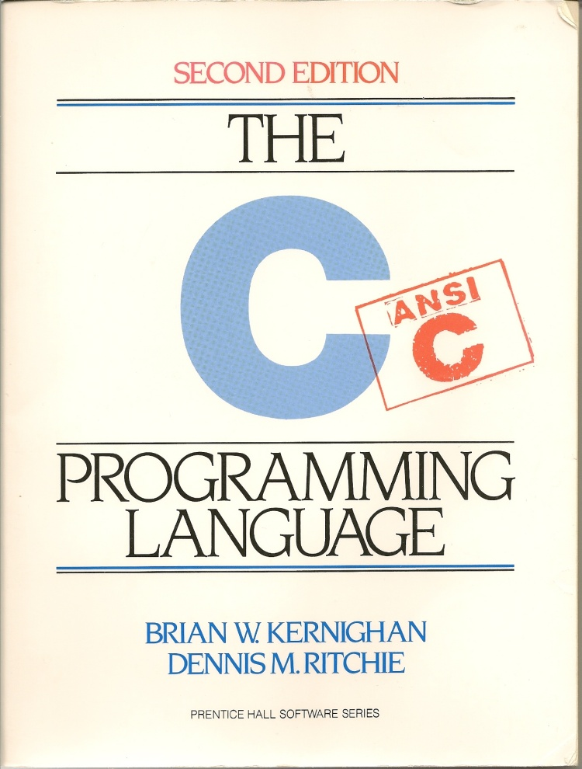
Textbooks (continued)
Third edition is essential!
64-bit assembly code, stack format, calling conventions, etc.
Second edition is out of date!
32-bit assembly code, stack format, calling conventions, etc.

Slide 19
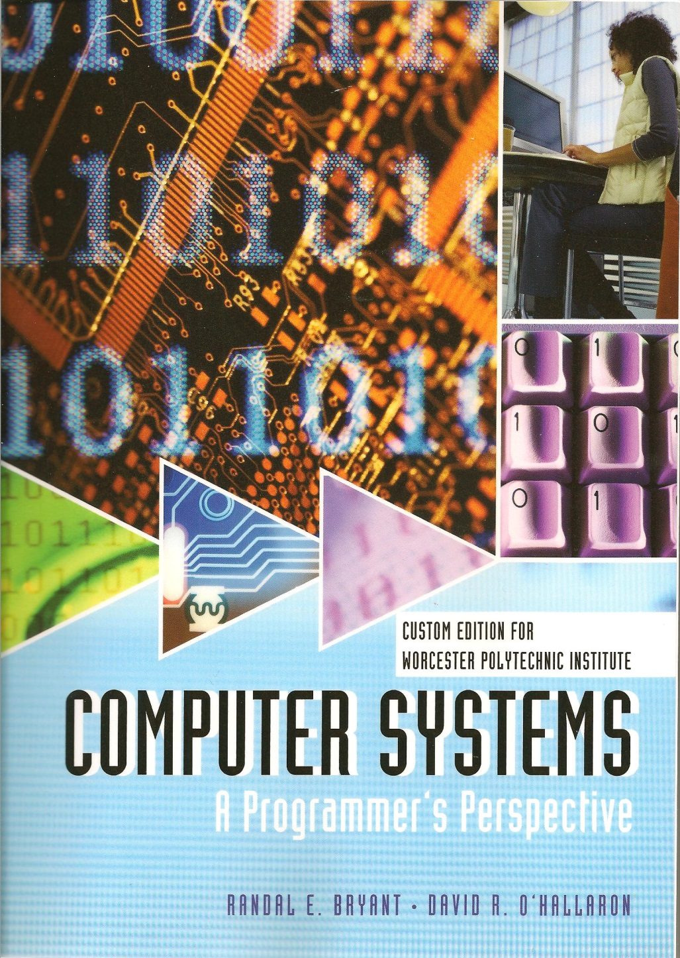
Custom 3rd edition (chapters 1, 2, 3 and 5, 6, 7)

Slide 20
Tomorrow’s Recitation Session
Introduction to Datalab

Slide 21
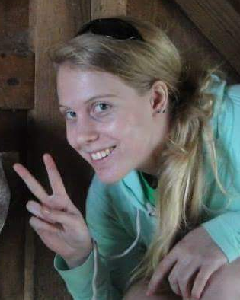
TAs and SAs
Rachel Plante

Slide 22
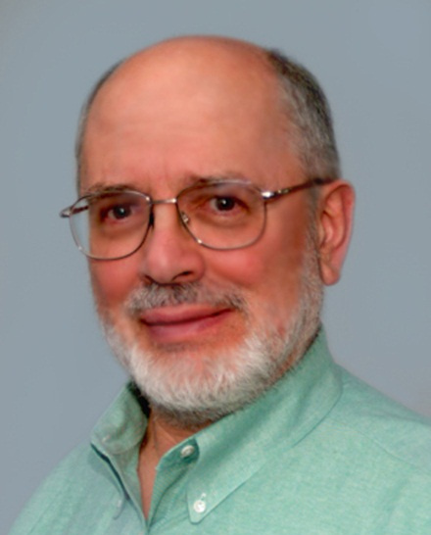
Teaching staff
Ph. D. Carnegie-Mellon, 1972-73
Dissertation “Correctness in Operating Systems”
Faculty at University of Newcastle upon Tyne, UK
30+ years in industry in USA
WPI since 2006
21 US patents issued
2 seminal contributions to Computer Science
Hugh C. Lauer
Adjunct Professor

Slide 23
Reading Assignment — Chapter 1 of Bryant and O’Hallaron
We will assume full knowledge of this chapter throughout the course
There may be questions on the contents of this chapter on any quiz

Slide 24
Grading
40-45% quizzes
Final quiz is worth 2 times any other quiz
40-45% Lab projects
Roughly equal in weight
10-20% Class and Recitation participation
Helping each other
Contributing to discussion groups
Asking questions & asking for help
It is in your interest that the Professor and TAs know you by name
Please don’t be embarrassed/annoyed if we ask you often

Slide 25
Getting Help
Class Web Page: http://www.cs.wpi.edu/~cs2011/b17
Complete schedule of lectures, exams, and assignments
Copies of lectures, assignments, exams, solutions
Clarifications to assignments
Canvas
Repository for copyright materials (lecture notes)
Linked directly from course web page
Submissions (backup for course servers)
Lecture Capture
Lectures will be recorded using WPI’s Echo Lecture Capturing system.
Link on Canvas home page for this course

Slide 26
Getting Help
Course mailing list: cs2011-all@cs.wpi.edu
Use as discussion list
Staff mailing list: cs2011-staff@cs.wpi.edu
Use this for ALL communication with the teaching staff
Send email to individual instructors or TAs only to schedule appointments
Office hours (Prof. Lauer):
Monday, TBD
Tuesday, TBD
Thursday, TBD
Friday, TBD
1:1 Appointments
You can schedule 1:1 appointments with Professor or any of the TAs

Slide 27
Ground Rule #1
There are no “stupid” questions.
It is a waste of your time and the class’s time to proceed when you don’t understand the basic terms.
If you don’t understand it, someone else probably doesn’t it, either.
Notes:
27

Slide 28
Ground Rule #2
Help each other!
Even when a project or assignment is specified as individual, ask your friends or classmates about stuff you don’t understand.
It is a waste of your time try to figure out some obscure detail on your own when there are lots of resources around.
When you have the answer, write it in your own words (or own coding style).
Notes:
28

Slide 29
Names and Faces
It is in your own interest that I know who you are.
Class picture — will circulate next time
Students who speak up in class usually get more favorable grades than those who don’t
When speaking in class, please identify yourselves

Slide 30
Policies: Assignments (Labs) And Exams
No work groups or project teams
You must work alone on all assignments (unless otherwise specified)
Canvas
Assignments due at 6:00 pm on the due date
Electronic turn-ins using Canvas (unless otherwise specified)
Conflict exams, other irreducible conflicts
Make PRIOR arrangements with Prof. Lauer
Notifying us well ahead of time shows maturity and makes us like you more (and thus to work harder to help you out of your problem)
Appealing grades
Within 7 days of completion of grading
Labs: Email to the staff mailing list
Quizzes: Talk to Prof. Lauer

Slide 31
Facilities
Lab projects to be completed on 64-bit Ubuntu virtual machines
gcc for compilation gdb for debugging Eclipse or Code::Blocks for GUI
DDD no longer supported!
You may use any other platform
On your own!
Projects graded on Ubuntu virtual machines
Some students have used nemiver as a gui debugger

Slide 32
Timeliness
Lateness penalties
5% per hour (first two hours)
10% per hour after that
Catastrophic events
Major illness, death in family, …
Formulate a plan (with your professor and academic advisor) to get back on track
Advice
Once you start running late, it’s really hard to catch up

Slide 33
WPI Honesty Policy
What is cheating?
Sharing code: by copying, pasting, retyping, looking at, or supplying a file
Coaching: helping your friend to write a program, line by line
Copying code from previous course or from elsewhere on WWW
Only allowed to use code we supply, or from CS:APP website
What is NOT cheating?
Explaining how to use systems or tools
Helping others with abstract design issues
Working out a problem together on a whiteboard, etc.
Diagrams of data structures — not code
Discussing outlines of algorithms in English, Chinese, etc!
…

Slide 34
WPI Honesty Policy (continued)
…
It is a violation of the WPI Academic Honesty Policy to submit someone else’s work as your own.
It is not a violation of WPI’s Academic Honesty Policy to ask for help!
Classmates, TAs, friends, mentors, …
Explanations of things you don’t understand

Slide 35
Unauthorized hacking
Any hacking into server will be treated as equivalent to Academic Dishonesty
Reported accordingly to Dean of Students Office.
If you suspect a vulnerability in any system, come and get permission to investigate BEFORE actually trying to probe.

Slide 36
Note on Quizzes
Open book, open notes
Many students have electronic textbooks
Kindle
Tablet
Laptop
Okay to consult electronic textbook, electronic copies of notes, lecture slides, etc.
May NOT connect to network, web, etc.

Slide 37
Topics for this course
Programs and Data
The Memory Hierarchy
Performance
Exceptions Control Flow
Virtual Memory
Networking and Concurrency

Slide 38
Questions?

Slide 39
On the Design
All slides are in Powerpoint 2007 (mix of PC and Mac versions)
Probably could be edited using Powerpoint 2003 plus
File format plugin
Calibri font
I would still recommend to use 2007 for editing
Design is suitable for printing out slides
Only light colors, in particular for boxes
Some slides have covered areas (that disappear later) suitable for quizzing in class
The design follows the Small Guide to Giving Presentations
Next slides: Color/format conventions

Slide 40
System-Level I/O CS-2011: Introduction to Machine Organization and Assembly Language 14th Lecture, Oct. 12, 2010
Style for title slides
Instructor:
Hugh C. Lauer

Slide 41
Today
Style for outlining
Unix I/O
RIO (robust I/O) package
Metadata, sharing, and redirection
Standard I/O
Conclusions and examples

Slide 42
Style for Figure Labels
Capitalize only the first word in each figure label
E.g., “Payload and padding”, not “Payload and Padding”, or “payload and padding”
This is the same style convention that we used in CS:APP2e.
Header
Size
a
a = 1: Allocated block
a = 0: Free block
Size: Total block size
Payload: Application data
(allocated blocks only)
Format of
allocated and
free blocks
Payload and
padding
Boundary tag
(footer)
Size
a

Slide 43
Style for Code
/*
* hello.c - Pthreads "hello, world" program
*/
#include "csapp.h"
void *thread(void *vargp);
int main() {
pthread_t tid;
Pthread_create(&tid, NULL, thread, NULL);
Pthread_join(tid, NULL);
exit(0);
}
/* thread routine */
void *thread(void *vargp) {
printf("Hello, world!\n");
return NULL;
}

Slide 44
Style for Code and Alternative Code
C Code
Goto Version
int fact_do(int x)
{
int result = 1;
do {
result *= x;
x = x-1;
} while (x > 1);
return result;
}
int fact_goto(int x)
{
int result = 1;
loop:
result *= x;
x = x-1;
if (x > 1)
goto loop;
return result;
}

Slide 45
Style for Assembly Code: Version I
int absdiff(int x, int y)
{
int result;
if (x > y) {
result = x-y;
} else {
result = y-x;
}
return result;
}
absdiff:
pushl %ebp
movl %esp, %ebp
movl 8(%ebp), %edx
movl 12(%ebp), %eax
cmpl %eax, %edx
jle .L7
subl %eax, %edx
movl %edx, %eax
.L8:
leave
ret
.L7:
subl %edx, %eax
jmp .L8
Setup
Body1
Finish
Body2

Slide 46
Style for Assembly Code: Version II
struct rec {
int i;
int a[3];
int *p;
};
void
set_p(struct rec *r)
{
r->p =
&r->a[r->i];
}
# %edx = r
movl (%edx),%ecx # r->i
leal 0(,%ecx,4),%eax # 4*(r->i)
leal 4(%edx,%eax),%eax # r+4+4*(r->i)
movl %eax,16(%edx) # Update r->p

Slide 47
Linux Command Prompt
linux> ./badcnt
BOOM! cnt=198841183
linux> ./badcnt
BOOM! cnt=198261801
linux> ./badcnt
BOOM! cnt=198269672

Slide 48
Stack and Registers
Caller
Frame
%eax
Caller-save
%edx
Arguments
%ecx
Return addr
%ebx
%ebp
Old %ebp
Callee-save
%esi
Saved
registers
+
Local
variables
%edi
%esp
Special
%ebp
Argument
build
%esp

Slide 49
Bar Plot
CPU Seconds
String Length

Slide 50
Tables
Cycles per element (or per mult)
Machine | Nocona | Core 2
rfact | 15.5 | 6.0
fact | 10.0 | 3.0
Method | Int (add/mult) |  | Float (add/mult)
combine4 | 2.2 | 10.0 | 5.0 | 7.0
unroll2 | 1.5 | 10.0 | 5.0 | 7.0
unroll2-ra | 1.56 | 5.0 | 2.75 | 3.62
bound | 1.0 | 1.0 | 2.0 | 2.0
Some instructions take > 1 cycle, but can be pipelined
Instruction Latency Cycles/Issue
Load / Store 5 1
Integer Multiply 10 1
Integer/Long Divide 36/106 36/106
Single/Double FP Multiply 7 2
Single/Double FP Add 5 2
Single/Double FP Divide 32/46 32/46

Slide 51
Color Palette
Boxes/areas:
Assembly, memory, …
Linux, memory, …
Code, …
Code, registers, …
Registers, …
Memory, …
Memory, …
Occasionally, use darker versions of above colors
Text:
Emphasizing something in the text
Comments inside yellow code boxes

